Slide 1
Economic Data for St Lucia: Preliminary Findings
Ramesh Chaitoo
International Trade Consultant
rnmsts@yahoo.ca
fc185627@skynet.be
Background Seminar for Senior Officials re Discussion of a Services Policy for St Lucia
Castries, February 20, 2012

Slide 2
General outline

Slide 3
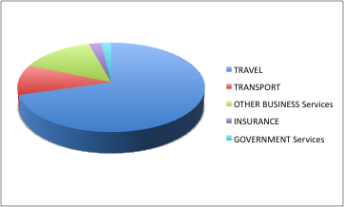
Sectoral Composition of GDP – St Lucia, 2010

Slide 4
Sectoral Composition of GDP – St Lucia, 2009

Slide 5
Employment by Sector – St Lucia
Employment 2001 - 2008 ('000) per Sector
 | Average 2001 - 2004 | 2005 | 2006 | 2007 | 2008
Total Employment | 63.930 | 68.930 | 67.180 | 72.780 | 71.900
Agriculture | 10.328 | 9.050 | 5.960 | 8.270 | 7.650
Manufacturing | 5.098 | 4.720 | 3.860 | 4.160 | 3.020
Construction | 5.518 | 7.530 | 8.050 | 8.940 | 7.290
Electricity, Gas & Water | 553 | 500 | 760 | 420 | 600
Wholesale & Retail Trade | 10.105 | 10.030 | 11.540 | 11.210 | 10.870
Hotels & Restaurants | 7.713 | 8.690 | 8.760 | 8.870 | 11.510
Communications | 3.968 | 4.170 | 3.340 | 4.370 | 5.180
Banking & Insurance | 1.188 | 1.600 | 1.860 | 1.090 | 1.660
Real Estate | 2.275 | 2.680 | 2.800 | 2.950 | 1.970

Slide 6
FDI Inflows – St Lucia (EC$ mill)

Slide 7
FDI stock in St Lucia (EC$ mill.)

Slide 8
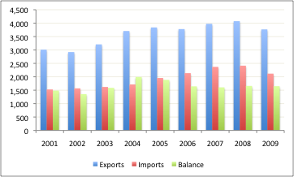
Sectoral Distribution of Credit – St Lucia, 2009

Slide 9
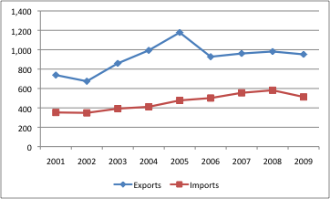
St Lucia Services Trade (EC$ mill)

Slide 10
Policy Frameworks for Services?
Specific Policies?
ANT –
DOM –
GDA –
KNA –
SLU – Tourism
SVG – Offshore finance, ICT
Specific Incentives?
ANT –
DOM –
GDA –
KNA –
SLU – Tourism
SVG – Offshore finance, ICT

Slide 11
Export Strategies
DOM – Export strategy targets culture, professional, construction, wellness tourism.
SLU – 2004 Export Strategy - Arts & entertainment, architecture, ICT, Integrated Marketing Communications, nursing, tourism.
GDA – Export Strategy? – tourism, business services, education, construction & engineering. Also has ICT strategy; health & wellness tourism strategy in process.
SVG – Export strategy still in process; ICT strategy.
KNA – 2006 Adaptation strategy – Tourism, ICT, financial services.
ANT – Information void; ICT?

Slide 12
Foreign Investment Strategies
Unclear regarding what governments say in terms of attracting investors.
All OECS have incentives for tourism sector for many years.
Some incentives for offshore financial services firms
No clear image for any country – like Mauritius for ICT hub, health tourism.

Slide 13
Health Tourism
Common OECS Tourism Policy discussed in August 2011 but health tourism is not part of that agenda.
Given the massive size and age structure of the US and Canadian populations, future prospects for health tourism may be the greatest of all targeted sectors
But it requires focused, organized effort and significant new investment in infrastructure, standards, training, proper air links, etc. etc.

Slide 14
Overall Assessment of Supply Side
St Lucia is really ready for exports to US & Canada in any of the targeted sectors, except perhaps, ICT.
Too few players,
Firms too small & not really outward oriented
Very segmented markets in spite of Economic Union
Standards do not meet international expectations
Lack of relevant education and training – failure at the basic CXC level.
Training shortfall in technical areas?

Slide 15
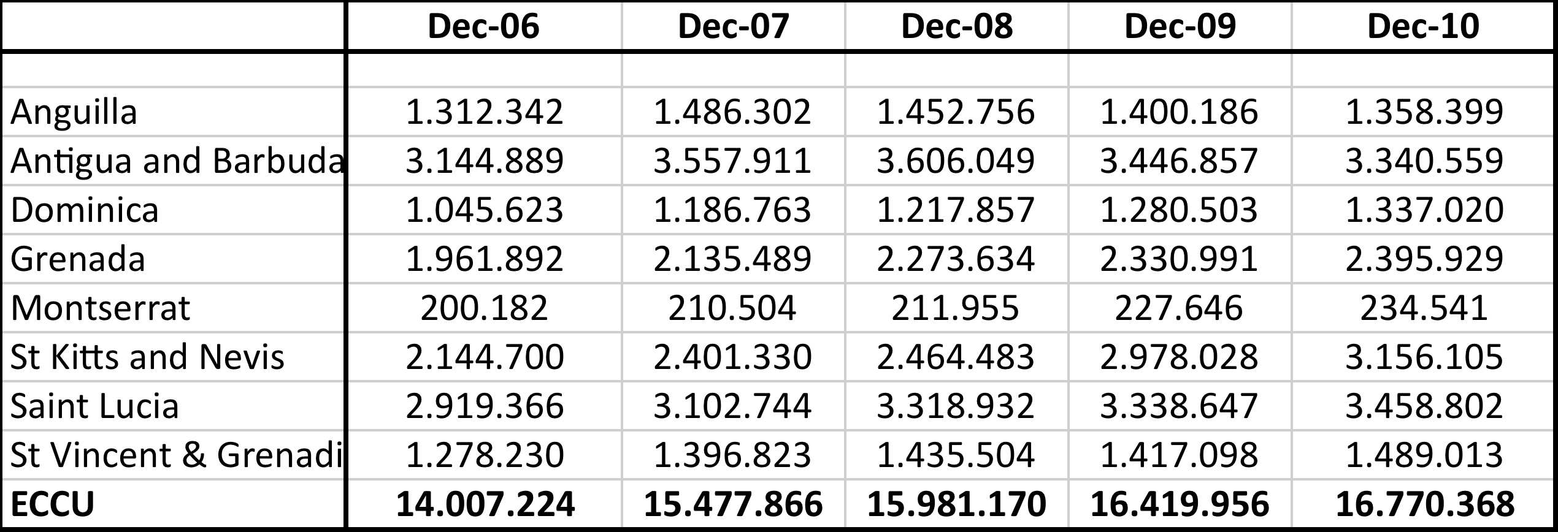
Total Deposits in OECS Commercial Banks (EC$ 000)

Slide 16
THANK YOU
RAMESH CHAITOO
International Trade Consultant
rnmsts@yahoo.ca
fc185627@skynet.be

